Slide 1
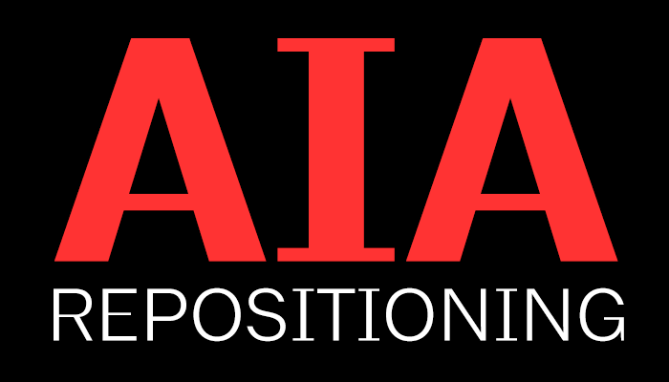
AIA Nebraska

Slide 2
AIA National Launches
New Requirements
Repositioning Initiative

Slide 3
In conjunction with AIA National repositioning efforts, effective in 2016 AIA state and local chapters are required to meet certain core member services and become accredited for a three-year period.
>member communications
>quality education and access to education
>advocacy
>elevation of public awareness
>compliance with governance policies
>engaging and recruiting members
>conducting finances and operations with transparency

Slide 4
Member Communications
Promote value of AIA membership
Promote AIA resources to members
Support AIA brand

Slide 5
Education
Collaborate statewide to ensure access to 18 credits per year of continuing education
Ensure quality continuing education
Offer IDP support, ARE preparation and other resources to emerging professionals in pursuit of licensure and career development
Maintain member CES transcripts
Offer any AIA member, regardless of assigned component, a reasonable opportunity to participate in component Continuing Education programming

Slide 6
Advocate
Advance AIA legislative priorities
Engage regulatory entities
Empower members to advocate for themselves and their profession

Slide 7
Elevate Public Awareness
Promote public awareness of the value of design and the role of architects
Recognize members’ design excellence
Engage with local community

Slide 8
Governance
Comply with federal and state laws
Mitigate risk
Keep local, state and national strategic plans up to date and aligned
Develop visionary leaders to serve at local, state and national levels; participate in leadership conference

Slide 9
Membership
Actively recruit and retain members
Maintain member records in AIA database
Engage members in fellowship/community

Slide 10
Finances & General Operations
Conduct secure, transparent and timely financial practices
Offer touch points (phone, website, email, etc.) to members and the public
Participate in AIA volunteer and component staff and volunteer training opportunities

Slide 11
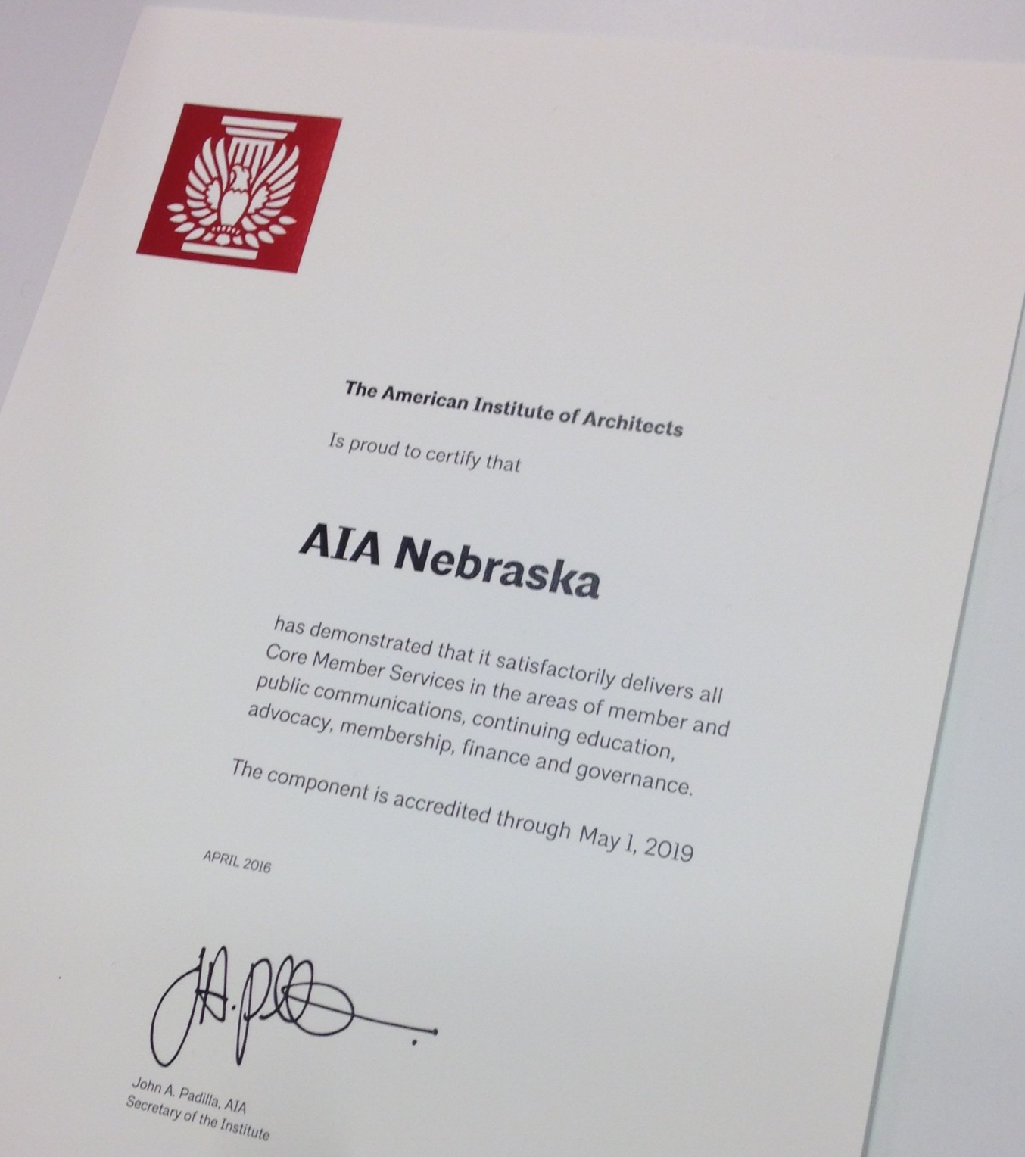

Slide 12
Accreditation Met
AIA Nebraska has been awarded a three-year accreditation and local chapters a one-year accreditation in recognition of our commitment to excellence in providing service to members. The accreditation signifies that AIA Nebraska and AIA Omaha, AIA Lincoln and AIA Western Nebraska provide quality service to members and meets or exceeds all core standards for components as set by AIA.

Slide 13
Repositioning
After over a year of study and exploration by the AIA Nebraska Board of Directors, and leadership of AIA Omaha, AIA Lincoln and AIA Western Nebraska, a proposed new structure is being recommended in accordance with AIA National repositioning. This reorganization helps us streamline, so that we may offer more services and benefits to our members while facilitating additional collaboration between our statewide network of AIA members.

Slide 14
Recommendation
This matter has been discussed and voted in support by each chapter's (Omaha, Lincoln and Western Nebraska) board of directors. The simplified structure is a decision that was made after input from leaders of Nebraska's local chapters, research from around the country on how other chapters are reorganizing and advice from our legal expert.
The result of diverse ideas and challenging questions is a proposed organization that will be stronger at both the State and Local levels, providing a platform for growth that will allow us to lead the nation in providing new and exciting ways to serve our members and represent our profession.

Slide 15
Proposed New Structure

Slide 16
Proposed New Structure: GOAL
To create ONE AIA chapter in Nebraska, with three sections. Omaha, Lincoln, and Western Nebraska.

Slide 17
Proposed New Structure: LEADERSHIP
Each Section will be structured much in the same way the chapters are today; each Section will have an elected Board of Directors and executive leadership.
AIA Nebraska Board of Directors will be comprised of representatives from each of the three sections.
The AIA Nebraska Nominations Committee will be comprised of representatives from each section.

Slide 18
Proposed New Structure: LEADERSHIP (cont.)
AIA Nebraska will be the administrative vehicle of the organization. In this role, the Nebraska Executive Committee will absorb the fiduciary responsibilities for all sections. Assuming responsibility for accounting services for the entire state (i.e., collecting annual budgets from each of the sections, completing all of the required financial, organizational and tax reporting; processing invoices and providing insurance).

Slide 19
Proposed New Structure: VOICE
Each section will continue to vote at AIA National meetings and Central States meetings.
Decisions about annual budgets, member services, programs and benefits will be made collaboratively between the state and section level.

Slide 20
Proposed New Structure: MEMBER FOCUS
Sections are able to focus their efforts on member services. No paperwork requirements with the IRS, State of Nebraska or AIA National.
New structure will provide AIA NE members with a more streamlined organization and allow sections the ability to spend more time on programs, while also gaining more support resources.

Slide 21
Proposed New Structure: FUNDING
AIA Nebraska: $226 + $70 (local) = $296 + Natl $265 = $561.00
Associate Nebraska: $67 + $55 (local) = $1232+ Natl $114 = $248.00
Members will make one payment for their state and local dues.

Slide 22
Proposed New Structure: FUNDING (cont.)
The sections will still have control of their existing funds and beginning in 2017 receive half of member dues to continue lectures and other programming. The other half will be specifically utilized for meeting core member services and having a greater presence.

Slide 23
Next Steps

Slide 24
Upcoming Meetings
August 18, 2016 - AIA Nebraska Executive Committee
Majority vote in affirmative to recommend members support the following:
>Modernization of AIA Nebraska bylaws
>New Articles of Incorporation – Revising name from AIA NE, A Society Chapter of the American Institute of Architects
>Plan of Merger between AIA Nebraska, Omaha, Lincoln, and Western NE
Upcoming Board of Directors meetings of AIA Omaha, AIA Lincoln, AIA Western To be Voted Upon:
>Plan of merger between AIA Nebraska and respective local chapter.
September 30, 2016 - AIA Nebraska Membership Meeting
Majority vote in affirmative:
>Modernization of AIA Nebraska bylaws
>New Articles of Incorporation - Revising name from AIA NE, A Society Chapter of the American Institute of Architects
>Plan of Merger between AIA Nebraska, Omaha, Lincoln, and Western NE

Slide 25
Chapter Meeting
Following the AIA NE Membership meeting, AIA Chapters will caucus and vote on the plan of merger in conjunction with the AIA Nebraska Membership meeting or at their annual membership meeting.
Pending Approval: New structure effective January 1, 2017

Slide 26
Questions?

